Slide 1









Slide 2

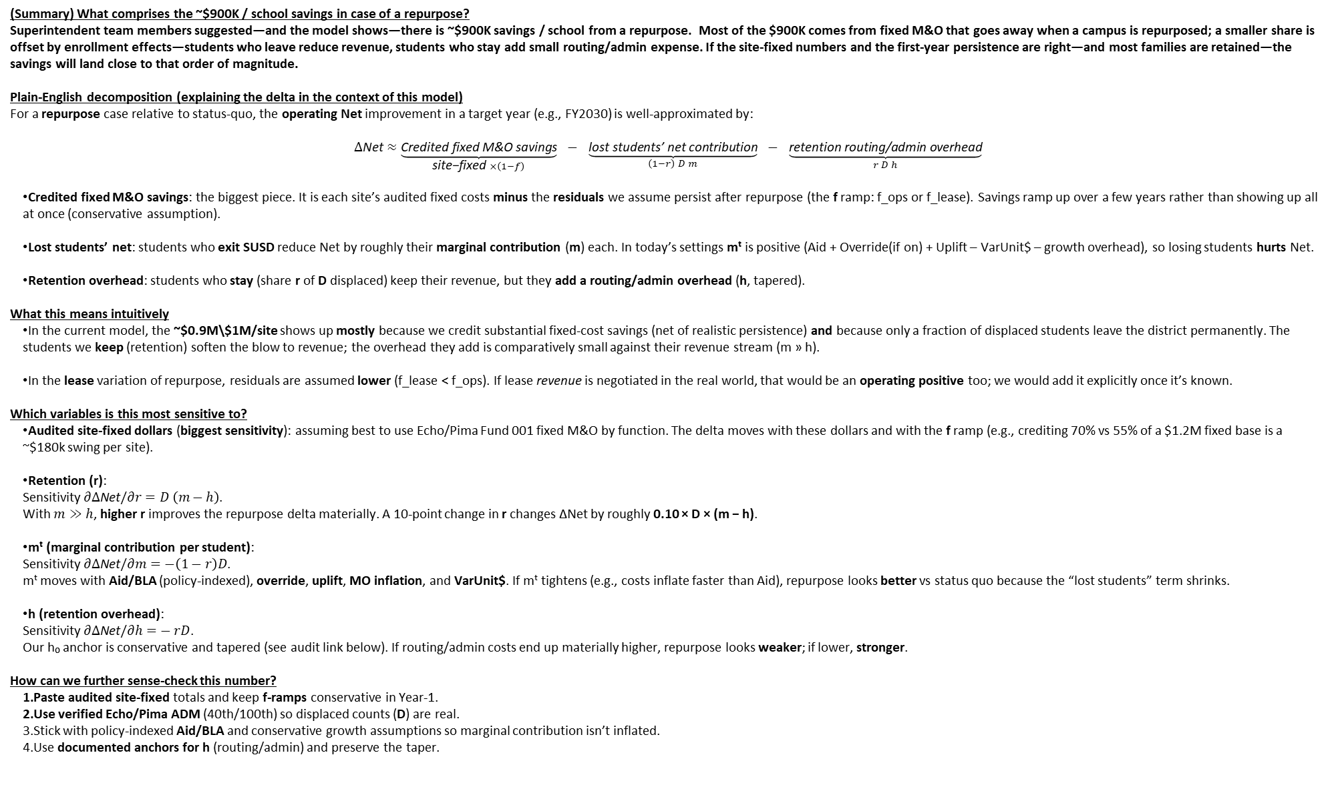
(Summary) What comprises the ~$900K / school savings in case of a repurpose?
Superintendent team members suggested—and the model shows—there is ~$900K savings / school from a repurpose. Most of the $900K comes from fixed M&O that goes away when a campus is repurposed; a smaller share is offset by enrollment effects—students who leave reduce revenue, students who stay add small routing/admin expense. If the site‑fixed numbers and the first‑year persistence are right—and most families are retained—the savings will land close to that order of magnitude.
Plain‑English decomposition (explaining the delta in the context of this model)
For a repurpose case relative to status‑quo, the operating Net improvement in a target year (e.g., FY2030) is well‑approximated by:
$$Δ\text{Net}≈\underset{\text{site}\text{−}\text{fixed} ×\left(1−f\right)}{\underbrace{\text{Credited} \text{fixed} \text{M}\text{\&}\text{O} \text{savings}}} − \underset{\left(1−r\right) D m}{\underbrace{\text{lost} \text{students}\text{’ }\text{net} \text{contribution}}} − \underset{r D h}{\underbrace{\text{retention} \text{routing}\text{/}\text{admin} \text{overhead}}}$$
Credited fixed M&O savings: the biggest piece. It is each site’s audited fixed costs minus the residuals we assume persist after repurpose (the f ramp: f_ops or f_lease). Savings ramp up over a few years rather than showing up all at once (conservative assumption).
Lost students’ net: students who exit SUSD reduce Net by roughly their marginal contribution (m) each. In today’s settings mᵗ is positive (Aid + Override(if on) + Uplift – VarUnit$ – growth overhead), so losing students hurts Net.
Retention overhead: students who stay (share r of D displaced) keep their revenue, but they add a routing/admin overhead (h, tapered).
What this means intuitively
In the current model, the ~$0.9M\$1M/site shows up mostly because we credit substantial fixed‑cost savings (net of realistic persistence) and because only a fraction of displaced students leave the district permanently. The students we keep (retention) soften the blow to revenue; the overhead they add is comparatively small against their revenue stream (m » h).
In the lease variation of repurpose, residuals are assumed lower (f_lease < f_ops). If lease revenue is negotiated in the real world, that would be an operating positive too; we would add it explicitly once it’s known.
Which variables is this most sensitive to?
Audited site‑fixed dollars (biggest sensitivity): assuming best to use Echo/Pima Fund 001 fixed M&O by function. The delta moves with these dollars and with the f ramp (e.g., crediting 70% vs 55% of a $1.2M fixed base is a ~$180k swing per site).
Retention (r): Sensitivity $∂Δ\text{Net}/∂r=D \left(m−h\right)$. With $m≫h$, higher r improves the repurpose delta materially. A 10‑point change in r changes ΔNet by roughly 0.10 × D × (m − h).
mᵗ (marginal contribution per student): Sensitivity $∂Δ\text{Net}/∂m=−\left(1−r\right)D$. mᵗ moves with Aid/BLA (policy‑indexed), override, uplift, MO inflation, and VarUnit$. If mᵗ tightens (e.g., costs inflate faster than Aid), repurpose looks better vs status quo because the “lost students” term shrinks.
h (retention overhead): Sensitivity $∂Δ\text{Net}/∂h=− rD$. Our h₀ anchor is conservative and tapered (see audit link below). If routing/admin costs end up materially higher, repurpose looks weaker; if lower, stronger.
How can we further sense-check this number?
Paste audited site‑fixed totals and keep f‑ramps conservative in Year‑1.
Use verified Echo/Pima ADM (40th/100th) so displaced counts (D) are real.
Stick with policy‑indexed Aid/BLA and conservative growth assumptions so marginal contribution isn’t inflated.
Use documented anchors for h (routing/admin) and preserve the taper.
(Summary) What comprises the ~$900K-$1M / school savings in case of a repurpose?
Superintendent team members suggested—and the model shows—there is ~$900K savings / school from a repurpose. Most of the $900K comes from fixed M&O that goes away when a campus is repurposed; a smaller share is offset by enrollment effects—students who leave reduce revenue, students who stay add small routing/admin expense. If the site‑fixed numbers and the first‑year persistence are right—and most families are retained—the savings will land close to that order of magnitude.

Slide 3
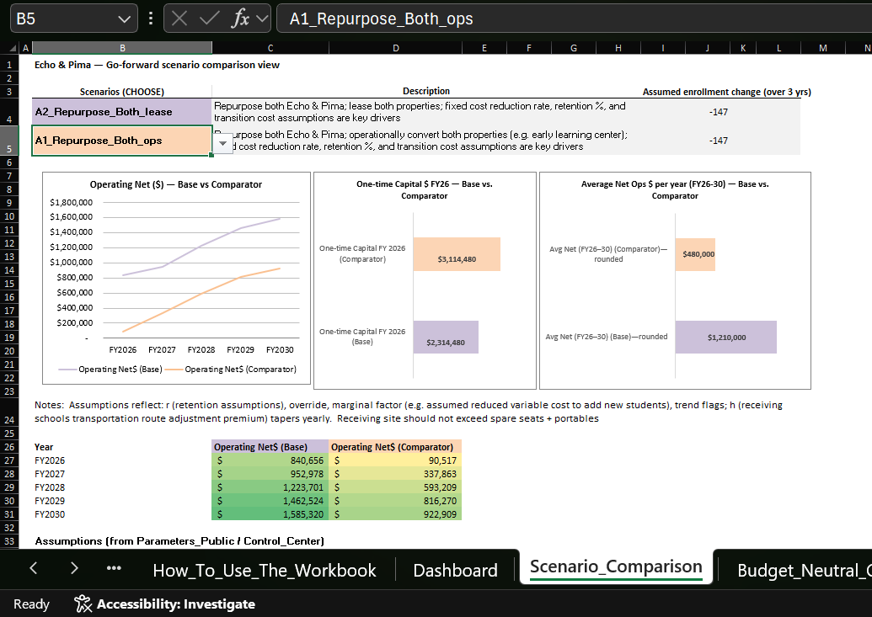

Slide 4
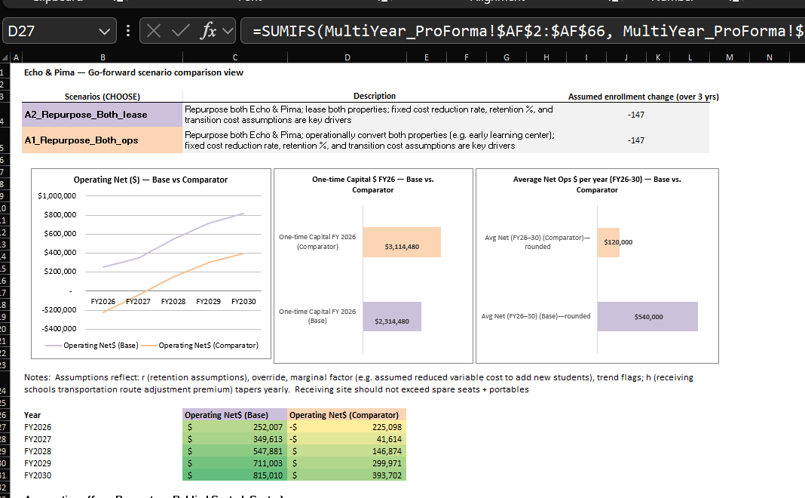

Slide 5
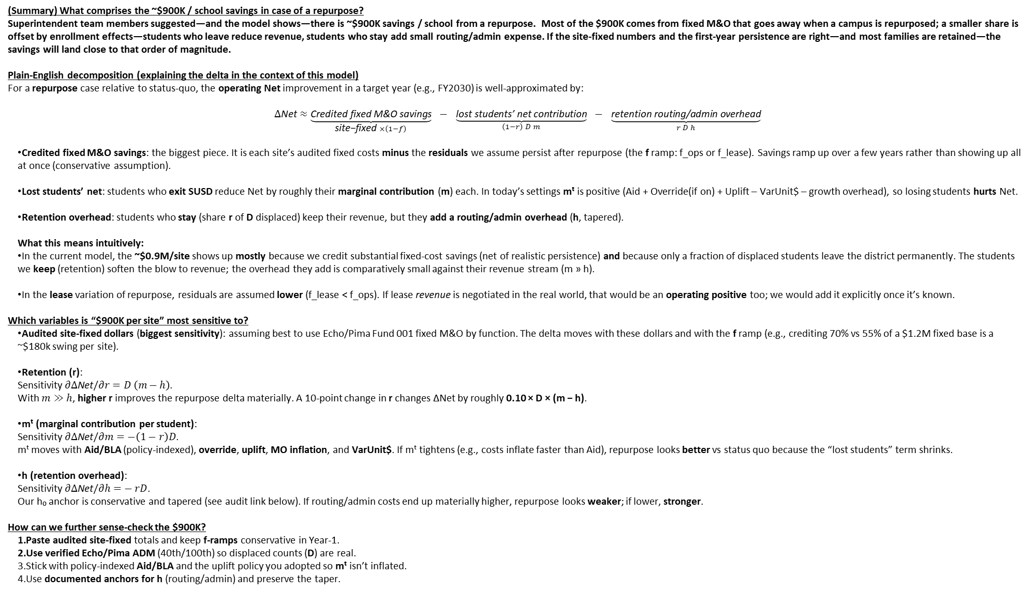
(Summary) What comprises the ~$900K / school savings in case of a repurpose?
Superintendent team members suggested—and the model shows—there is ~$900K savings / school from a repurpose. Most of the $900K comes from fixed M&O that goes away when a campus is repurposed; a smaller share is offset by enrollment effects—students who leave reduce revenue, students who stay add small routing/admin expense. If the site‑fixed numbers and the first‑year persistence are right—and most families are retained—the savings will land close to that order of magnitude.
Plain‑English decomposition (explaining the delta in the context of this model)
For a repurpose case relative to status‑quo, the operating Net improvement in a target year (e.g., FY2030) is well‑approximated by:
$$Δ\text{Net}≈\underset{\text{site}\text{−}\text{fixed} ×\left(1−f\right)}{\underbrace{\text{Credited} \text{fixed} \text{M}\text{\&}\text{O} \text{savings}}} − \underset{\left(1−r\right) D m}{\underbrace{\text{lost} \text{students}\text{’ }\text{net} \text{contribution}}} − \underset{r D h}{\underbrace{\text{retention} \text{routing}\text{/}\text{admin} \text{overhead}}}$$
Credited fixed M&O savings: the biggest piece. It is each site’s audited fixed costs minus the residuals we assume persist after repurpose (the f ramp: f_ops or f_lease). Savings ramp up over a few years rather than showing up all at once (conservative assumption).
Lost students’ net: students who exit SUSD reduce Net by roughly their marginal contribution (m) each. In today’s settings mᵗ is positive (Aid + Override(if on) + Uplift – VarUnit$ – growth overhead), so losing students hurts Net.
Retention overhead: students who stay (share r of D displaced) keep their revenue, but they add a routing/admin overhead (h, tapered).
What this means intuitively:
In the current model, the ~$0.9M/site shows up mostly because we credit substantial fixed‑cost savings (net of realistic persistence) and because only a fraction of displaced students leave the district permanently. The students we keep (retention) soften the blow to revenue; the overhead they add is comparatively small against their revenue stream (m » h).
In the lease variation of repurpose, residuals are assumed lower (f_lease < f_ops). If lease revenue is negotiated in the real world, that would be an operating positive too; we would add it explicitly once it’s known.
Which variables is “$900K per site” most sensitive to?
Audited site‑fixed dollars (biggest sensitivity): assuming best to use Echo/Pima Fund 001 fixed M&O by function. The delta moves with these dollars and with the f ramp (e.g., crediting 70% vs 55% of a $1.2M fixed base is a ~$180k swing per site).
Retention (r): Sensitivity $∂Δ\text{Net}/∂r=D \left(m−h\right)$. With $m≫h$, higher r improves the repurpose delta materially. A 10‑point change in r changes ΔNet by roughly 0.10 × D × (m − h).
mᵗ (marginal contribution per student): Sensitivity $∂Δ\text{Net}/∂m=−\left(1−r\right)D$. mᵗ moves with Aid/BLA (policy‑indexed), override, uplift, MO inflation, and VarUnit$. If mᵗ tightens (e.g., costs inflate faster than Aid), repurpose looks better vs status quo because the “lost students” term shrinks.
h (retention overhead): Sensitivity $∂Δ\text{Net}/∂h=− rD$. Our h₀ anchor is conservative and tapered (see audit link below). If routing/admin costs end up materially higher, repurpose looks weaker; if lower, stronger.
How can we further sense-check the $900K?
Paste audited site‑fixed totals and keep f‑ramps conservative in Year‑1.
Use verified Echo/Pima ADM (40th/100th) so displaced counts (D) are real.
Stick with policy‑indexed Aid/BLA and the uplift policy you adopted so mᵗ isn’t inflated.
Use documented anchors for h (routing/admin) and preserve the taper.

Slide 6

How to answer the Board’s “What is the ~$900K per school?” question
Plain‑English decomposition (what drives the delta in our model):
For a repurpose case relative to status‑quo, the operating Net improvement in a target year (e.g., FY2030) is well‑approximated by:
$$Δ\text{Net}≈\underset{\text{site}\text{−}\text{fixed} ×\left(1−f\right)}{\underbrace{\text{Credited} \text{fixed} \text{M}\text{\&}\text{O} \text{savings}}} − \underset{\text{lost} \text{students}\text{’ }\text{net} \text{contribution}}{\underbrace{\left(1−r\right) D m}} − \underset{\text{retention} \text{routing}\text{/}\text{admin} \text{overhead}}{\underbrace{r D h}}$$
Credited fixed M&O savings: the biggest piece. It is each site’s audited fixed costs minus the residuals we assume persist after repurpose (the f ramp: f_ops or f_lease). Savings ramp up over a few years rather than showing up all at once (that’s our conservative posture).
Lost students’ net: students who exit SUSD reduce Net by roughly their marginal contribution (m) each. Under today’s settings mᵗ is positive (Aid + Override(if on) + Uplift – VarUnit$ – growth overhead), so losing students hurts Net.
Retention overhead: students who stay (share r of D displaced) keep their revenue, but they add a routing/admin overhead (h, tapered).
What this means intuitively:
In the current build, that ~$0.9M/site shows up mostly because we credit substantial fixed‑cost savings (net of realistic persistence) and because only a fraction of displaced students leave the district permanently. The students we keep (retention) soften the blow to revenue; the overhead they add is comparatively small against their revenue stream (m » h).
In the lease flavor, residuals are assumed lower (f_lease < f_ops). If lease revenue is negotiated in the real world, that would be an operating positive too; we would add it explicitly once it’s known.
Which variables is “$900K per site” most sensitive to?
Audited site‑fixed dollars (biggest sensitivity): best to use Echo/Pima Fund 001 fixed M&O by function. The delta moves with these dollars and with the f ramp (e.g., crediting 70% vs 55% of a $1.2M fixed base is a ~$180k swing per site).
Retention (r): Sensitivity $∂Δ\text{Net}/∂r=D \left(m−h\right)$. With $m≫h$, higher r improves the repurpose delta materially. A 10‑point change in r changes ΔNet by roughly 0.10 × D × (m − h).
mᵗ (marginal contribution per student): Sensitivity $∂Δ\text{Net}/∂m=−\left(1−r\right)D$. mᵗ moves with Aid/BLA (policy‑indexed), override, uplift, MO inflation, and VarUnit$. If mᵗ tightens (e.g., costs inflate faster than Aid), repurpose looks better vs status quo because the “lost students” term shrinks.
h (retention overhead): Sensitivity $∂Δ\text{Net}/∂h=− rD$. Our h₀ anchor is conservative and tapered (see audit link below). If routing/admin costs end up materially higher, repurpose looks weaker; if lower, stronger.
What must be “right” to be near $900K?
Paste audited site‑fixed totals and keep f‑ramps conservative in Year‑1.
Use verified Echo/Pima ADM (40th/100th) so displaced counts (D) are real.
Stick with policy‑indexed Aid/BLA and the uplift policy you adopted so mᵗ isn’t inflated.
Use documented anchors for h (routing/admin) and preserve the taper.
Board‑friendly line: “Most of the $900K comes from fixed M&O that goes away when a campus is repurposed; a smaller share is offset by enrollment effects—students who leave reduce revenue, students who stay add small routing/admin expense. If we get the site‑fixed numbers and the first‑year persistence right—and we retain most families—the savings will land close to that order of magnitude.”

Slide 7
How to answer the Board’s “What is the ~$900K per school?” question
Plain‑English decomposition (what drives the delta in our model):
For a repurpose case relative to status‑quo, the operating Net improvement in a target year (e.g., FY2030) is well‑approximated by:
$$Δ\text{Net}≈\underset{\text{site}\text{−}\text{fixed} ×\left(1−f\right)}{\underbrace{\text{Credited} \text{fixed} \text{M}\text{\&}\text{O} \text{savings}}} − \underset{\text{lost} \text{students}\text{’ }\text{net} \text{contribution}}{\underbrace{\left(1−r\right) D m}} − \underset{\text{retention} \text{routing}\text{/}\text{admin} \text{overhead}}{\underbrace{r D h}}$$
Credited fixed M&O savings: the biggest piece. It is each site’s audited fixed costs minus the residuals we assume persist after repurpose (the f ramp: f_ops or f_lease). Savings ramp up over a few years rather than showing up all at once (that’s our conservative posture).
Lost students’ net: students who exit SUSD reduce Net by roughly their marginal contribution (m) each. Under today’s settings mᵗ is positive (Aid + Override(if on) + Uplift – VarUnit$ – growth overhead), so losing students hurts Net.
Retention overhead: students who stay (share r of D displaced) keep their revenue, but they add a routing/admin overhead (h, tapered).
What this means intuitively:
In the current build, that ~$0.9M/site shows up mostly because we credit substantial fixed‑cost savings (net of realistic persistence) and because only a fraction of displaced students leave the district permanently. The students we keep (retention) soften the blow to revenue; the overhead they add is comparatively small against their revenue stream (m » h).
In the lease flavor, residuals are assumed lower (f_lease < f_ops). If lease revenue is negotiated in the real world, that would be an operating positive too; we would add it explicitly once it’s known.
Which variables is “$900K per site” most sensitive to?
Audited site‑fixed dollars (biggest sensitivity): best to use Echo/Pima Fund 001 fixed M&O by function. The delta moves with these dollars and with the f ramp (e.g., crediting 70% vs 55% of a $1.2M fixed base is a ~$180k swing per site).
Retention (r): Sensitivity $∂Δ\text{Net}/∂r=D \left(m−h\right)$. With $m≫h$, higher r improves the repurpose delta materially. A 10‑point change in r changes ΔNet by roughly 0.10 × D × (m − h).
mᵗ (marginal contribution per student): Sensitivity $∂Δ\text{Net}/∂m=−\left(1−r\right)D$. mᵗ moves with Aid/BLA (policy‑indexed), override, uplift, MO inflation, and VarUnit$. If mᵗ tightens (e.g., costs inflate faster than Aid), repurpose looks better vs status quo because the “lost students” term shrinks.
h (retention overhead): Sensitivity $∂Δ\text{Net}/∂h=− rD$. Our h₀ anchor is conservative and tapered (see audit link below). If routing/admin costs end up materially higher, repurpose looks weaker; if lower, stronger.
What must be “right” to be near $900K?
Paste audited site‑fixed totals and keep f‑ramps conservative in Year‑1.
Use verified Echo/Pima ADM (40th/100th) so displaced counts (D) are real.
Stick with policy‑indexed Aid/BLA and the uplift policy you adopted so mᵗ isn’t inflated.
Use documented anchors for h (routing/admin) and preserve the taper.
Board‑friendly line: “Most of the $900K comes from fixed M&O that goes away when a campus is repurposed; a smaller share is offset by enrollment effects—students who leave reduce revenue, students who stay add small routing/admin expense. If we get the site‑fixed numbers and the first‑year persistence right—and we retain most families—the savings will land close to that order of magnitude.”

